Slide 1
Figma vs Adobe XD
Wich is the best choice?
PRESENTED BY: José David Ortega, Erik Santiago Alegría y Esneider Astudillo Benavides
Date : 16/03/2026

Slide 2
Introduction To Tools:
Figma is a cloud-based interface design (UI) and user experience (UX) tool. It is globally recognized as the MOST COLLABORATIVE platform because it allows several designers to work on the same file at the same time, just like a shared Google document.
Adobe XD (Experience Design) is a software tool from the Adobe family created to design prototypes for websites and mobile applications. It is characterized by being lighter and faster than other Adobe programs like Photoshop, focusing exclusively on interactive design.

Slide 3
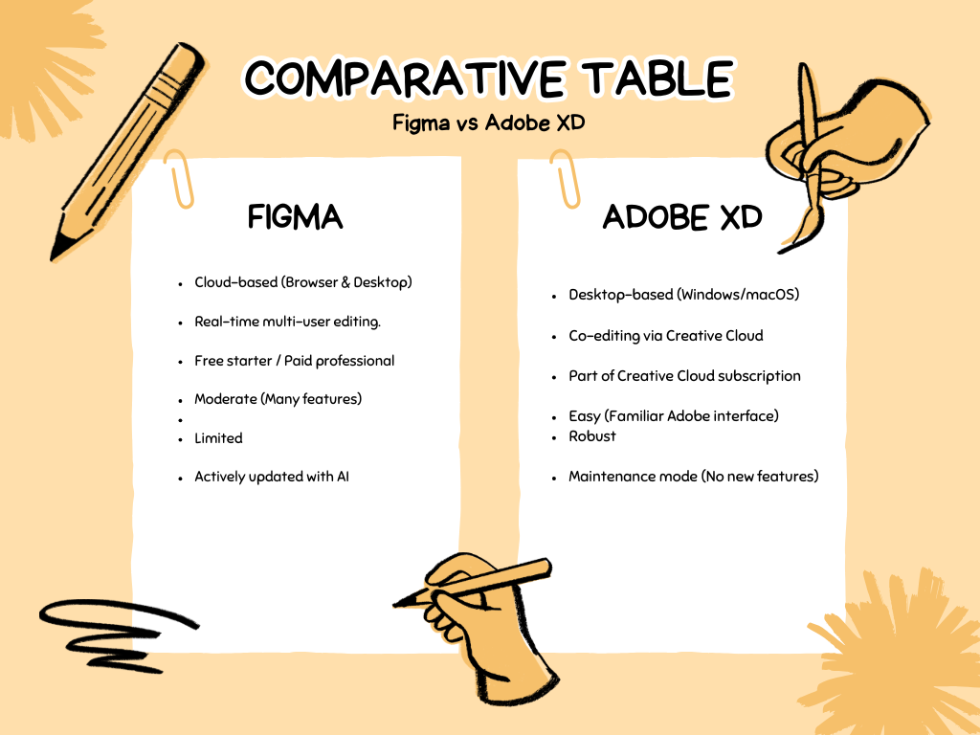

Slide 4
Conclusion:
While Adobe XD is a stable and familiar tool for those already in the Adobe ecosystem, it is no longer receiving major updates. Figma has become the industry standard due to its cloud-native approach.

